Slide 1
Microelectronics and VLSI Design IT 705 D
Module 1: Introduction to VLSI Design

Slide 2
Modules
Module 1 - Introduction to VLSI Design
Module 2 - MOS Structure
Module 3 - Microelectronics Processes for VLSI Fabrication
Module 4 - Hardware Description Language

Slide 3
Module 1: Introduction to VLSI Design
VLSI Design Concept
Moore’s Law
Scale of Integration
Types of VLSI Chips
Design Principles
Design Domains
Digital VLSI Design Steps

Slide 4
Introduction
Very-large-scale integration (VLSI) is the process of creating an integrated circuit (IC) by combining thousands of transistors into a single chip.
VLSI began in the 1970s when complex semiconductor and communication technologies were being developed.
The microprocessor is a VLSI device.
Before the introduction of VLSI technology most ICs had a limited set of functions they could perform.
An electronic circuit might consist of a CPU, ROM, RAM and other glue logic.
VLSI lets IC designers add all of these into one chip.

Slide 5
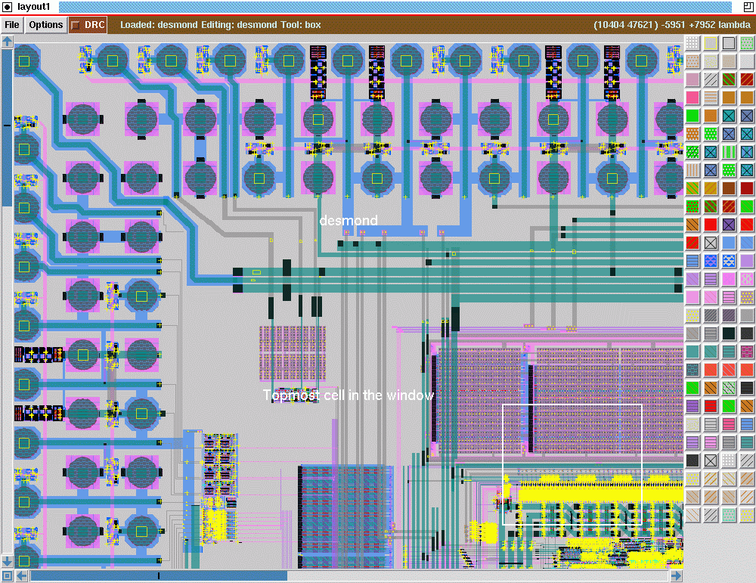
VLSI Chip (Example Diagram)

Slide 6
Evolution: towards VLSI
The first semiconductor chip held two transistors each. Subsequent advances added more transistors, and as a consequence, more individual functions or systems were integrated over time.
The first integrated circuit held only a few devices, perhaps as many as ten diodes, transistors, resistors and capacitors, making it possible to fabricate one or more logic gates on a single device. This is now known as small-scale integration (SSI).
Improvements in technique led to devices with hundreds of logic gates, known as medium-scale integration (MSI).
Further improvements led to large-scale integration (LSI), i.e. systems with at least a thousand logic gates.
Current technology has moved far past this mark and today's microprocessors have many millions of gates and billions of individual transistors. The concept of VLSI came.
In 2008, billion-transistor processors became commercially available.

Slide 7
VLSI – At present
VLSI became more commonplace as semiconductor fabrication advanced from the then-current generation of 65 nm processes.
Current designs, unlike the earliest devices, use extensive design automation and automated logic synthesis to lay out the transistors, enabling higher levels of complexity in the resulting logic functionality.
Certain high-performance logic blocks like the SRAM (static random-access memory) cell, are still designed by hand to ensure the highest efficiency.

Slide 8
Moore’s Law
Moore's law is the observation that the number of transistors in a dense integrated circuit doubles approximately every two years.
The observation is named after Gordon Moore, the co-founder of Intel, whose 1965 paper described a doubling every year in the number of components per integrated circuit, and projected this rate of growth would continue for at least another decade. In 1975, looking forward to the next decade, he revised the forecast to doubling every two years.

Slide 9
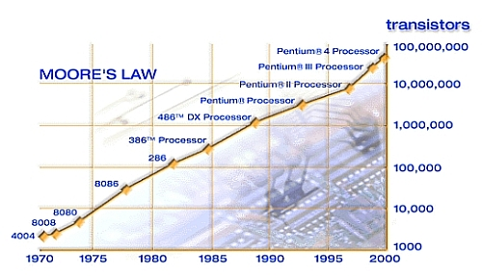
Moore’s Law (2)

Slide 10
Scale of Integration
Name | Signification | Year | Transistors number | Logic gates number
SSI | small-scale integration | 1964 | 1 to 10 | 1 to 12
MSI | medium-scale integration | 1968 | 10 to 500 | 13 to 99
LSI | large-scale integration | 1971 | 500 to 20,000 | 100 to 9,999
VLSI | very large-scale integration | 1980 | 20,000 to 1,000,000 | 10,000 to 99,999
ULSI | ultra-large-scale integration | 1984 | 1,000,000 and more | 100,000 and more

Slide 11
Types of VLSI Chips
CMOS chip
DSP chip
Dynamic and Static RAM chip
ROM Chip
FPGA chip
Gate Array chip

Slide 12
CMOS Chip
Complementary metal-oxide semiconductor (CMOS) chips are two transistors made from two field effect transistors of different types, placed together on the same circuit.
These types of chips are particularly fast and can operate using minimal power.
However, the chips are vulnerable to static electricity damage.
These chips usually are used for RAM and switching.

Slide 13
DSP Chip
A digital signal processor (DSP) is a type of chip used to manipulate data.
DSP chips are involved in sending, interpreting and acquiring information

Slide 14
Dynamic and Static RAM Chips
Dynamic and static RAM chips are used to store information.
Dynamic RAM chips store their information on integrated circuits that contain capacitors.
Operation of dynamic RAM chip is slow because of user pipelining. It can serve one user at any time instant .
This drawback does not occur with static RAM chips.
However, dynamic RAM chips can store far more information than static RAM.
Usually, a static RAM chip can store only one quarter of the memory (25%) that a dynamic RAM chip can.

Slide 15
ROM Chip
Read-only memory (ROM) chips are integral parts of any computer system.
These chips contain data or instructions that can be read but never changed.
These chips are manufactured with data already stored upon them.

Slide 16
FPGA Chips
Field programmable gate array (FPGA) VLSI chips can be reprogrammed after they are purchased.
Therefore, they can be made into functional chips for any use that the purchaser requires.
This saves the purchasers’ hassle of manufacturing their own chips.
However, FPGA chips usually cannot utilize their full potential, leaving many cell sites unused

Slide 17
GATE Array Chips
Gate array design VLSI chips are manufactured to be easier for the purchasers to adapt to their own needs.
However, these chips accomplish the goal using different methods than the FPGA chips.
The gate array chips are designed with a general "mask" or a general programming configuration, with many transistors on the chip left uncommitted.
The chip can later be reprogrammed.

Slide 18
Design Principles
Less area/volume and therefore, compactness
Less power consumption
Less testing requirements at system level
Higher reliability, mainly due to improved on-chip interconnects
Higher speed, due to significantly reduced interconnection length
Significant cost savings

Slide 19
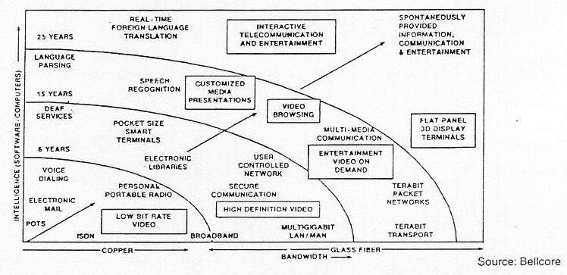
Trends of IT with emerging VLSI Concept

Slide 20
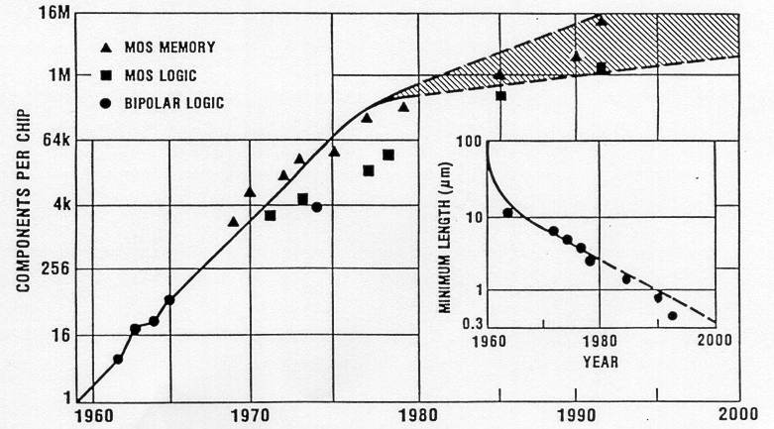
Increasing Efficiency of VLSI Chip (1960 – 2000)

Slide 21
VLSI Design Domains
The Y-chart (first introduced by D. Gajski) illustrates a design flow for most logic chips, using design activities on three different axes (domains) which resemble the letter Y.
The Y-chart consists of three major domains, namely:
Behavioral domain,
Structural domain,
Geometrical layout domain.

Slide 22
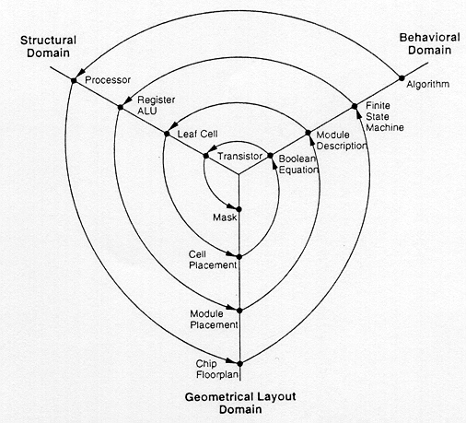
Y - Chart

Slide 23
VLSI Design Flow (1)
The design flow starts from the algorithm that describes the behavior of the target chip.
The corresponding architecture of the processor is first defined. It is mapped onto the chip surface by floorplanning.
The next design evolution in the behavioral domain defines finite state machines (FSMs) which are structurally implemented with functional modules such as registers and arithmetic logic units (ALUs).
These modules are then geometrically placed onto the chip surface using CAD tools for automatic module placement followed by routing, with a goal of minimizing the interconnects area and signal delays.

Slide 24
VLSI Design Flow (2)
The third evolution starts with a behavioral module description. Individual modules are then implemented with leaf cells.
At this stage the chip is described in terms of logic gates (leaf cells), which can be placed and interconnected by using a cell placement & routing program.
The last evolution involves a detailed Boolean description of leaf cells followed by a transistor level implementation of leaf cells and mask generation.
In standard-cell based design, leaf cells are already pre-designed and stored in a library for logic design use.

Slide 25
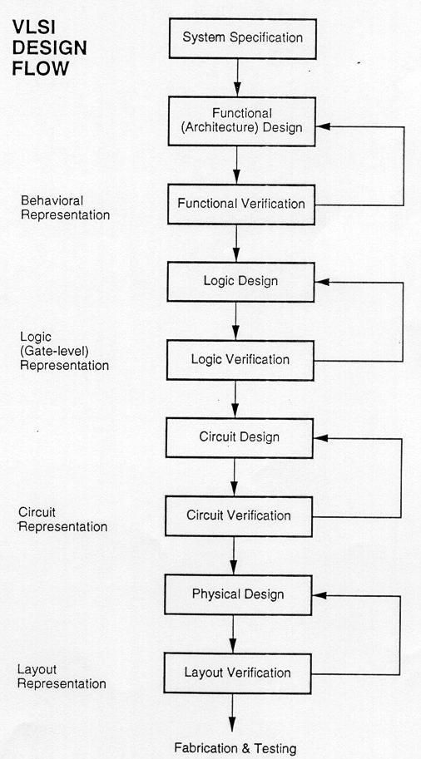
Simplified View

Slide 26
Digital Design (Hierarchical / Divide & Conquer Approach)
As an example of structural hierarchy, Structural decomposition of a CMOS four-bit adder into its components.
The adder can be decomposed progressively into one- bit adders, separate carry and sum circuits, and finally, into individual logic gates.
At this lower level of the hierarchy, the design of a simple circuit realizing a well-defined Boolean function is much more easier to handle than at the higher levels of the hierarchy.

Slide 27
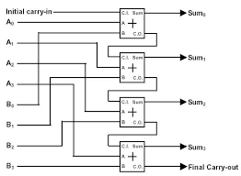
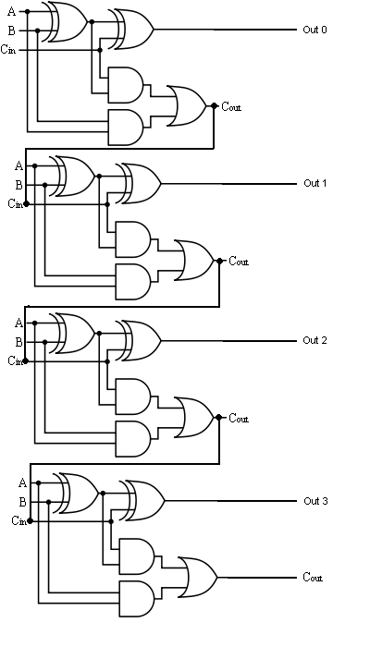
Digital Design (Hierarchical / Divide & Conquer Approach)
Illustration with an example of 4bit adder circuit

Slide 28
Theory: 4 bit Full Adder
A binary adder is a digital circuit that produces the arithmetic sum of two binary numbers. It can be constructed with full adder connected in cascade, the output carry from each full adder connected to the input carry of the next full adder in the chain.
The augend bits of A and addend bits of B are designated by subscript numbers from right to left , with subscript 0 denoting the least significant bit. The carries are connected in the chain through the full adders. The input carry to the adder is C0 and it ripples through the full adder to the output carry C4.
The S output generate the required sum bits.

Slide 29
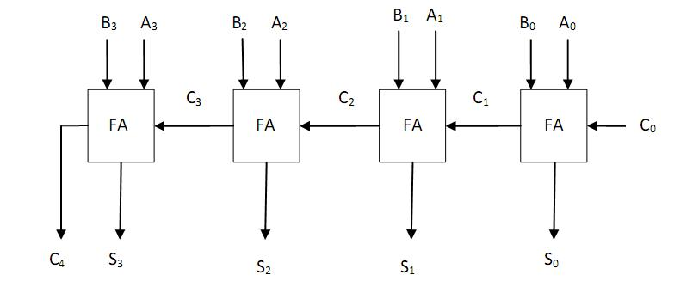
Block Diagram: 4 bit Full Adder

Slide 30
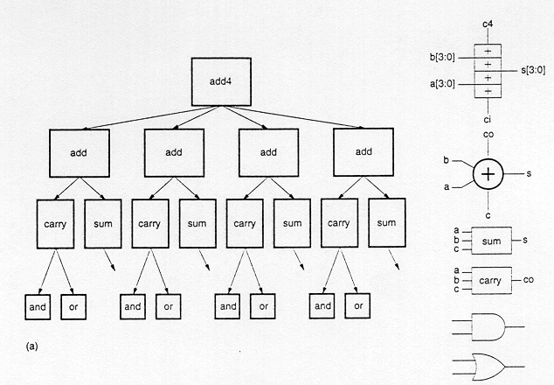
Digital Design (Hierarchical / Divide & Conquer Approach)

Slide 31
Digital Design (Hierarchical / Divide & Conquer Approach)
In the physical domain, partitioning a complex system into its various functional blocks will provide a valuable guidance for the actual realization of these blocks on chip.
Obviously, the approximate shape and size (area) of each sub-module should be estimated in order to provide a useful floorplan.
Hierarchical decomposition of a four-bit adder in physical description (geometrical layout) domain, results in a simple floorplan.
This physical view describes the external geometry of the adder, the locations of input and output pins, and how pin locations allow some signals (in this case the carry signals) to be transferred from one sub-block to the other without external routing.
At lower levels of the physical hierarchy, the internal mask layout of each adder cell defines the locations and the connections of each transistor and wire.

Slide 32
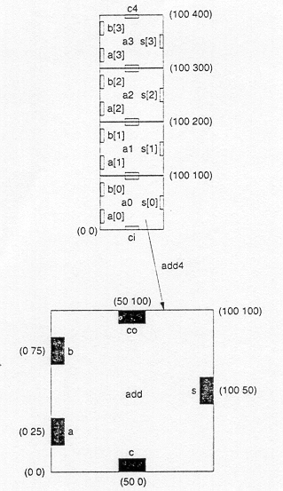
Figure shows the hierarchical decomposition of a four-bit adder in physical description (geometrical layout) domain, resulting in a simple floorplan

Slide 33
?

